Slide 1
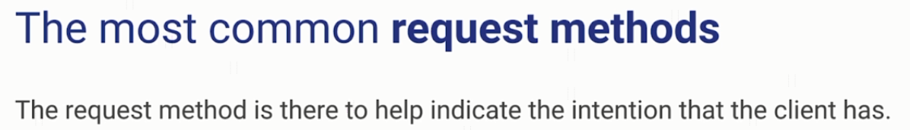

HTTP Request Methods

Slide 2
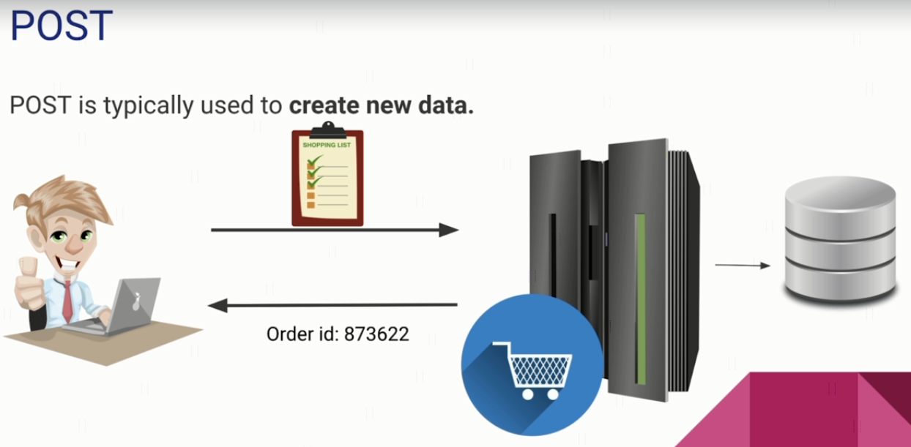
HTTP Request Methods

Slide 3
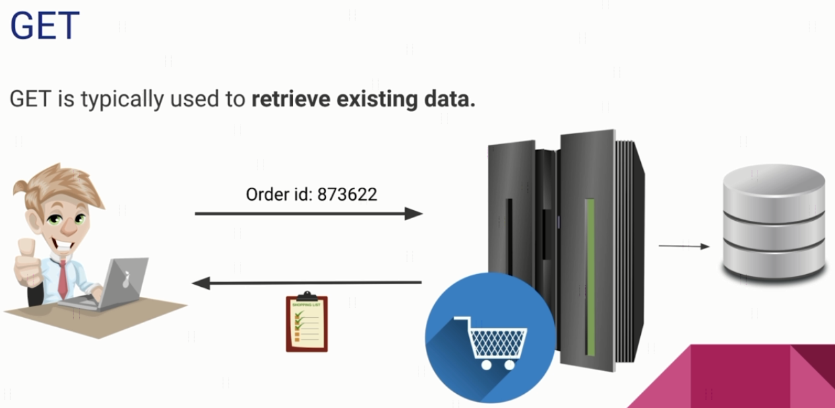
HTTP Request Methods

Slide 4
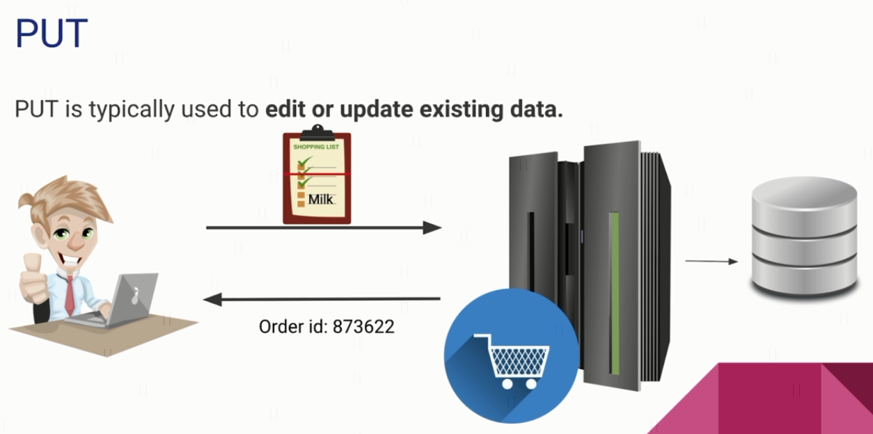
HTTP Request Methods

Slide 5
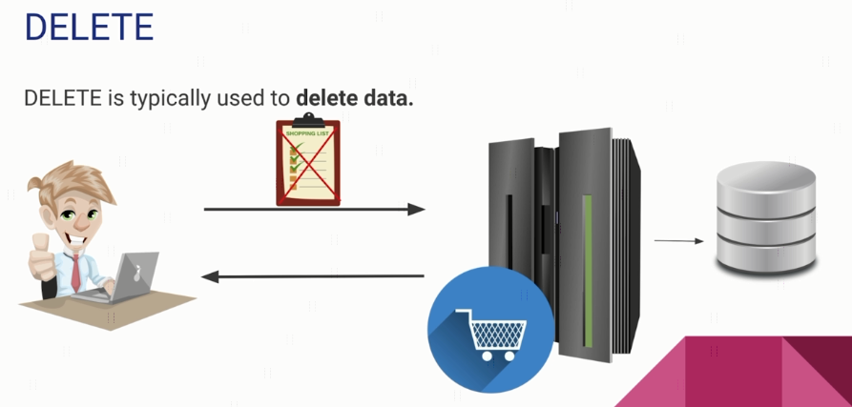
HTTP Request Methods

Slide 6
HTTP Message Structure
https://www.udemy.com/course/introduction-to-apis-rest-api-graphql-soap-web-services-grpc/learn/lecture/19945844#overview

